Slide 1
Data Visualization of Bird Strikes

Slide 2
Introduction
Overview: Transport and communication are critical domains in analytics, with environmental impacts and safety being major concerns.
Objective: To analyze bird strikes data to improve aircraft safety and develop strategies to mitigate such incidents.
Goal: Visualize data collected by FAA on bird strikes to identify patterns and trends.

Slide 3
Details of Data
It contains Information on bird strikes from 2000 to 2011.
Data cleaning was performed to address any missing values and ensure accurate data types.

Slide 4
Main KPIs
Number of Bird Strikes
Cost of Repairs
Altitude of Strikes
Phase of Flight
Weather Conditions
Pilot Warnings

Slide 5
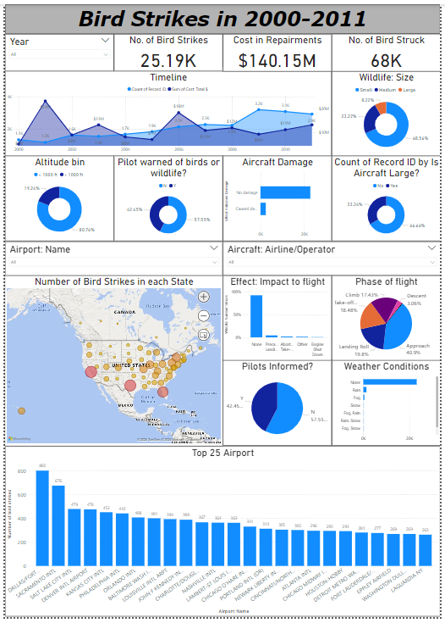
My Design

Slide 6
Thank you

